Slide 1
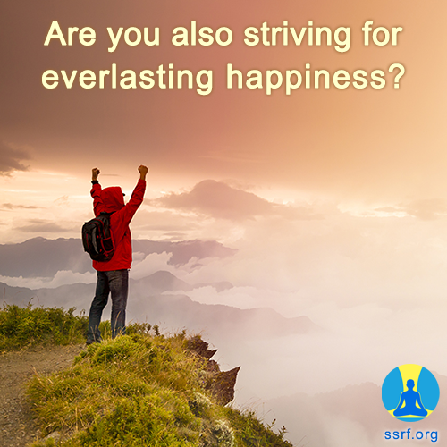

Slide 2
Personality Development by increasing Virtues
By securing good marks, we can pass only some academic examination; but by inculcating qualities, we can pass the examination of life !
- Dr Jayant Athavale (Founder, Sanatan Sanstha)

Slide 3
Gurukul System | Modern Education
12 years in company of Guru | 5 to 6 hours in a day with teacher
One has to do his own chores & ashram sevas, which helps to develop self sufficiency in kids | Dependent life style
Due to self sufficiency labor work has respect & unity in society | Labor work is given less importance causing division of society
64 kalas and 14 Vidhyas are taught,Hence understanding develops in detachement | Only 64 kalas are being taught and hence attachement is developed in Worldly things
Detached people (Spiritually Developed people ) are taken as Idle for society | All are attached and hence there is No ideal person, if at all there some Cine person or sports star (?)
Complete development of Personality takes place | Only worldly development occurs

Slide 4
Personality Development
Self defense & protecting others
Yoga, Surya-namaskar
Physical Development
30%
Psychological Development
Expressing happiness in others’ happiness
Intellectual Development
Grasping Memory
Decision making Creativity
Social Development
Gratitude towards society
Spiritual Development
Increasing virtues
70%

Slide 5
Spiritual Development
Increasing virtues
Self sufficiency - Promptness
Humbleness - Obedience
Appreciation - Honesty
Boldness - Sacrifice / Sharing
Thriftiness - Punctuality
Leadership - Tidiness / neatness

Slide 6
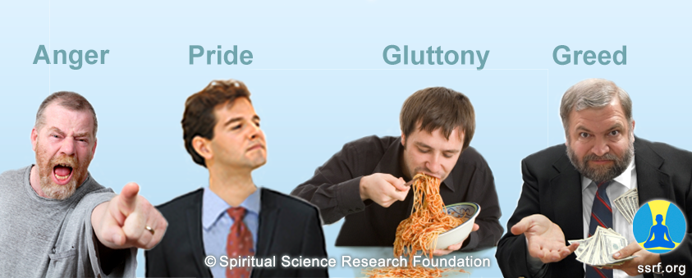
Spiritual Development
Personality Defect Removal
Types of Personality Defects
Affecting others & self
Affecting only self
Affecting others
Ex: 1.
2.
Ex: 1.
2.
Ex: 1.
2.

Slide 7
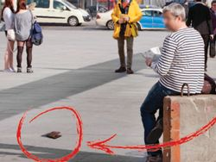
Function of Mind
Sub conscious mind
Conscious mind
Defects
Wrong action
(Sin)
Action by motor organ
Sense organs
Correct action
(merit)
Virtues
Intellect (buddhi)

Slide 8
Spiritual Development
Benefits of increasing virtues
Benefits of self sufficiency
1. Increase in efficiency
2. Promptness
3. Development of discipline
4. Increase in planning skills
5. Getting help & love from others
6. Developing self confidence
7. Ability to help others
8. Learning new things
9. Stress free life
Difficulties faced due to dependency
Inefficient
Laziness
Indiscipline
Unplanned
No cooperation from others
Lack of confidence
Will not be able to help others
Not able to learn
Stressful life
Actions to increase self sufficiency
Taking photocopy / scan on own at office Packing own couriers Packing own office / tiffin bag Cleaning own vehicle Polishing own shoes

Slide 9
Sample virtue inculcation chart
Selected virtues | Positive actions | Negative actions | Remedies
Humility |  | While I was making a craft item, my elder sister asked me, “What happened in school today”, upon which I rudely replied, “Can you not see that I am doing something ?” | Speaking with respect and humility with everyone is a virtue of an ideal child. I will convince my mind with this perspective or give autosuggestion as per technique 1
 | When we had guests at our place, I spoke respectfully to them
 |  | When father called me for dinner, I replied angrily, ”I will have dinner after watching the serial”. | When father called me for dinner, I politely asked him if I could come after watching the serial.

Slide 10
Spiritual Practice (Sadhana)
Karma
योगः कर्मसु कौशल्यं
Dnyan
Ego Removal
Bhakti
Awakening spiritual emotion
PD removal | Increasing Virtues
Laziness | Promptness
Rudeness | Humbleness
Disobedient | Obedient
Criticizing | Appreciating
1.Prayer 2.Gratitude 3.Control on anger
4. Respecting others wish
5. Accepting mistakes
6. Learning attitude (from persons & incidences)
1.Chanting
2.Awakening Spiritual Emotion
3.Atmanivedan
4.Preeti (love without expectations)
Notes:
A] Karma-Yoga
While doing any deed as per ‘Karma-Yoga’, it should be remembered that ‘Yogah Karmasu Kaushalam (Srimat Bhagavat Geeta- Chapter 2- Verse-50) which means every good deed should be done with skill, in perfect manner as it is ‘Yoga’.
B] Dnyan – Yoga: God is within me & God is everywhere. If God is within me, then why don’t I behave like God? It is because of Ego…. To reduce ego, simple 6 steps can be followed. Prayer (sakaam, nishkam ex), Gratitude: Que to Swami Vivekananda – what is moral? Having gratitude is moral….. Hence, gratitude for family, friends, society etc., Controling anger: a penny saved is like penny earned, thru anger we lose lot of energy…..
B] Bhakti-Yoga

Slide 11


